Slide 1
Design Patterns
Mandar Kulkarni

Slide 2
Introduction
Core solutions to recurring software design problems in real-world application development.
There are different problem situations while designing the system, and there are one or more patterns to address each problem situation.
The Gang of Four (Erich Gamma, Richard Helm, Ralph Johnson, and John Vlissides ) describes 23 design patterns. With patterns you don't have to reinvent the wheel and get proven solutions for frequently encountered problems

Slide 3
Why Design Patterns are important???
Technology/Language independent design practices, those help achieve resilient, highly performant, easily maintainable and cleanly extendible software applications/systems.
Ensure adherence to SOLID principles.
Algorithms are for processing logic, similarly Design Patterns for organizing components of a software systems.
No coding enthusiast is complete without the knowledge of design patterns

Slide 4
Types of Design Patterns
Creational patterns are ones that create objects for you, rather than having you instantiate objects directly. This gives your program more flexibility in deciding which objects need to be created for a given case
Factory Method, Abstract Factory, Prototype, Builder, Singleton
Structural patterns help you compose groups of objects into larger structures, such as complex user interfaces or accounting data
Adapter, Bridge, Façade, Decorator, Composite, Proxy, Flyweight
Behavioral patterns help you define the communication between objects in your system and how the flow is controlled in a complex program
Interpreter, Chain of responsibility, Command, Memento, Iterator, Visitor, Mediator, Observer, State, Strategy

Slide 5
RECAP - Class Diagram
Class Diagrams show the different classes that make up a system and how they relate to each other
Class Diagrams are said to be “static” diagrams because they show the classes, along with their methods and attributes as well as the static relationships between them: which classes “know” about which classes or which classes “are part” of another class, but do not show the method calls between them.

Slide 6


Class Associations
Generalization: Generalization association between two classes puts them in a hierarchy representing the concept of inheritance of a derived class from a base class
Associations: This represents a relationship between classes, and gives the common semantics and structure for many types of “connections” between objects.

Slide 7


Class Associations
Aggregation: Special type of associations in which the two participating classes don't have an equal status, but make a “whole-part” relationship.
Composition: Compositions form whole-part relationships as well, but the relationship is so strong that the parts cannot exist on its own. They exist only inside the whole, and if the whole is destroyed the parts die too.

Slide 8
Pre-Requisite : Basics of Java and OOAD
Abstract class is an abstraction of a class hierarchy where the default state and few behaviors may have been implemented and the remaining are left for the derived classes to implement/override.
public abstract class A
public class B extends A
Interface: It is an abstraction of a class hierarchy where only mandatory contract has been defined(with one or more default implementations for some of the behavior).It does not have any state definitions.
public interface X
public class Y implements X

Slide 9
Pre-Requisite : Basics of Java and OOAD
Basic OO concepts : Abstraction, Polymorphism, Encapsulation
OOAD principles:
Single Responsibility
Open Close
Liskov substitution
Interface Segregation
Dependency Inversion

Slide 10
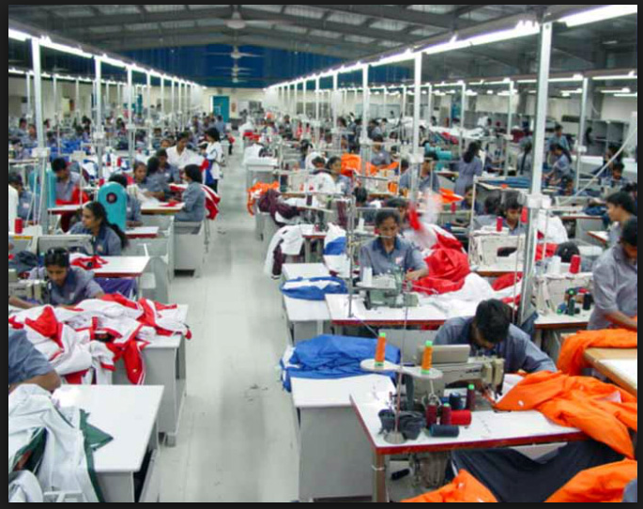
Garments Factory- a real world example

Slide 11
Garments Factory- a real world example - 1
Butterfly clothing and Garments Limited is in the business of manufacturing formal, informal fashion wear as well as suits for gents.
Since they design and manufacture different variety of clothing let’s give a generic name to any type of clothing as WEARABLE.
A Wearable is made up of various parts. For example: a shirt is made up of collars, sleeves, buttons/chain strip etc. etc.
They have a team of fashion designers who design a new “model” of a WEARABLE (shirt, trouser or a suite (comprising of coat, shirt, trouser)). The design is made on a computer, for each human size and then fed to a paper printer, which resembles a cloth sheet. The printer then marks various shapes required to manufacture that WEARABLE, in such a way that maximum cloth sheet is getting utilized and very less is wasted.
The marked paper sheet (for a given size such as Small, Large, Extra Large) then fed to a cloth sheet cutter which registers all shapes those need to be cut out from each cloth sheet.
The purchase team selects appropriate type and quality of cloth required for each design and as per the demand of units to be supplied.

Slide 12
Process Flow – Shirt/Blazer example
Design model( on Computer)
Create Paper specimen of model parts
Sleeves Stitching
Select and procure appropriate cloth, buttons, threads etc.
Inward quality check, washing, ironing
Body Stitching
Cloth Cutting
Collar Stitching
Button strip Stitching
QC
Washing, Ironing
Packaging
Trial

Slide 13
Garments Factory- a real world example - 2
The manufacturing unit comprises of production line each of it will contain
Inward quality check unit which checks for the quality of cloth, and components/accessories such as buttons, the sheets used for collars and so on.
A washing and ironing unit which carries out washing of cloth sheets according to set standards and then irons each of them at set temperature.
A cutting unit which makes use of the fed cutting data for a model and then cuts the sheets in bulk. This process element produces cloth parts/components required to assemble a WEARBLE product.
A production line is set for each model in such as a way that it will contain sewing units arranged in a pre-defined order, defined for each type of product (shirt, pant, suit etc.). Each sewing unit dedicated to stitching a part of a product such as sleeves, collars, body part, button strip with buttons, pocket etc. in case of shirts stitching. Similarly, a sewing unit each dedicated to stitching each leg, waistband, pleats, front/back pockets etc. in case of pant stitching. Similar production line will be set up for suits and so on.
Each employee on the production line is trained in assembling/stitching one (or max two) part of the wearable components. According they are assigned for working on those parts, so that it would ensure quality of work as well as maximize production efficiency.
The production line is followed by post production quality check where the quality of product manufactured, quality of stitching, fitness of defined measures etc. is verified.
Post-production ironing is followed.
Finally, a packaging unit packs the products into respective packing boxes/covers and makes them ready for delivery.

Slide 14
Garments Factory- a real world example - 2
Scenario 1: Trial of a new model design
Imagine that the designers have designed a new fashionable partywear shirt and carried out a simulation on computer, to validate how it will look on a average male body. But this verification was not enough as it could not give real world validation.
So they arranged a sample manufacturing of 3 pieces each of each of the sizes and carried out actual trial of men of various sizes, heights, color complexions and so on so as to verify the real look and feel.
This verification gave them required satisfaction of the design and it was approved for actual production and sent for manufacturing process.
This is an example of Proxy design pattern. The sample shirt acted as a proxy of the actual manufactured one, and used for necessary verification before the actual shirt is approved for manufacturing.

Slide 15
Garments Factory- a real world example - 3
Scenario 2: Manufacturing of a newly designed model
A WEARABLE model (say shirt) designed by the designer must have matching parts manufactured/procured for it, in order to justify the design aesthetics. The Sky blue colored formal shirt model will need supply of
Sky Blue cotton sheet
Sky blue colored buttons
Sky blue colored thread rolls
Sky blue colored collar sheet
There can be different providers for these parts. So their orders should be synchronized to procure parts of matching type and color.
This is an example of Abstract Factory (multiple factories synchronized with each other so that each targeted to supply a “RELATED” part so that the whole model will be a synchronized assembly of “family” of related components.

Slide 16
Garments Factory- a real world example - 3
Scenario 3: Standardization of the process of manufacturing of a WEARABLE
If you imagine the process of manufacturing of a shirt, regardless of its type(formal/informal), design and size is standard(cut shapes, stich body, pocket, left arm, right arm, collar, buttons)
But one or more of these process elements may differ in its actual implementation. For example: some shirts are body fit, whereas others are comfort fit, some may have single stich whereas others may have double stitching, some may have two pockets etc.
Thus the process containing sequence of above listed process elements is constant for a WEARBLE type “shirt”, but one or more process steps are “modified” suit the needs of a specific model design.
This is an example of Template method design pattern.

Slide 17
Garments Factory- a real world example - 4
Scenario 4: Alteration to the default model( and process) of a pant
The default model of any pant (any color, any size) is sort of standard, in the sense it has a waistband, two side pockets and a single back pocket. So a default production line set up for stitching a pant is as follows
Prepare right leg and attach a side pocket and a back pocket to it
Stitch left leg and attach a side pocket(only)to it.
Assemble waistband to both legs
A cargo pant requires a modification to this assembly, as it offers side external pockets on both legs.
So one (or two) process unit(s) is added to “decorate” the pant design, without modifying the current process so as to
Assemble right and left external pockets
Assemble buttons on these external pockets
This decoration of additional behavior in the standard pant manufacturing process, is an example of DECORATOR design pattern.

Slide 18
Garments Factory- a real world example - 5
Scenario 5: Production of two/three piece Suits
A Suit is a WEARABLE. It comprises of a COAT, a (matching) SHIRT, a (matching) PANT
Each of these are WEARABLE in themselves, in the sense each can be used independent of each other as well as together as a “SUIT”.
In other sense we can say that a SUIT is a “Composite” WEARABLE which contains other “leaf” WEARABLES such as shirt, coat and pant. The manufacturer can sell sit as a whole or coat, shirt, pant as individual wearables.
A “Composite Design Pattern”, what else?

Slide 19
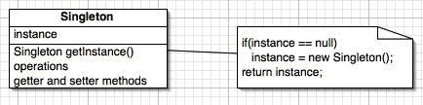
Singleton
In software engineering, the singleton pattern is a design pattern that is used to restrict instantiation of a class to one object.
Ensure a class has only one instance, and provide a global point of access to it.

Slide 20
public class SingletonObject
{
private static SingletonObject ref;
private SingletonObject()
{
// no code req'd
}
public static synchronized SingletonObject getSingletonObject()
{
if (ref == null)
{
ref = new SingletonObject();
}
return ref;
}
public Object clone() throws CloneNotSupportedException
{
throw new CloneNotSupportedException();
}
}

Slide 21
Singleton - Exceptions
It's possible to have multiple singleton instances if classes loaded by different class-loaders access a singleton. That scenario is not so far-fetched; for example, some servlet containers use distinct classloaders for each servlet, so if two servlets access a singleton, they will each have their own instance.
If Singleton class implements the java.io.Serializable interface, the class's instances can be serialized and deserialized. However, if you serialize a singleton object and subsequently deserialize that object more than once, you will have multiple singleton instances
Our purpose was to allow only 1 instance of the class but by making constructor private we have also restricted sub-classing (inheriting) from Singleton. If we want to allow sub-classing we should make constructor protected. But remember, in Java protected constructor can be executed from outside within the same package. So classes within same package will be able to create any number of instances. Here again,. one solution is to keep singletons in a package explicitly for Singletons.

Slide 22
Factory Method
It deals with the problem of creating objects (products) without specifying the exact class of object that will be created.
The factory method design pattern handles this problem by defining a separate method for creating the objects, which subclasses can then override to specify the derived type of product that will be created. More generally, the term factory method is often used to refer to any method whose main purpose is creation of objects.

Slide 23
Factory Method
Creator
# factoryMethod()
+ someOperation()
Product
ConcreteCreator
ConcreteProduct

Slide 24
Factory Method
EmployeeController
EmployeeCollection
Employee
Qualification
ITEmployee
Controller
AccEmployee
Controller
ITQualification
AccQualiication
ITEmployee
AccEmployee

Slide 25
public abstract class Employee {
private String name;
public Employee(String name) {
this.name = name;
}
public String getName() {
return name;
}
public abstract void manageWork();
}

Slide 26
public class AccEmployee extends Employee {
public AccEmployee(String name) { super(name); }
public void manageWork(){
System.out.println("Manage company accounts");
}
}
public class ITEmployee extends Employee {
public ITEmployee(String name) { super(name); }
public void manageWork(){
System.out.println("Managing software development");
}
}

Slide 27
abstract Class EmployeeController{
private List<Employee> employees;
//…
public void addEmployee(String name) {
//…accept name of a new employee
// Employee emp = new Employee(name)
Employee emp = createEmployee(name);
employees.add(emp);
//…
}
public abstract Employee createEmployee(String name);
//…
}

Slide 28
Class ITEmployeeController extends EmployeeController{
public Employee createEmployee( String name){
return new ITEmployee(name);
}
}
Class AccEmployeeController extends EmployeeController{
public Employee createEmployee(String name){
return new AccEmployee(name);
}
}

Slide 29
Observer Pattern
The observer pattern (sometimes known as publish/subscribe) is a design pattern used in computer programming to observe the state of an object in a program
The key objects in this pattern are subject and observer. A subject may have any number of dependent observers. All observers are notified whenever the subject undergoes a change in state. In response, each observer will query the subject to synchronize its state with the subject's state.

Slide 30
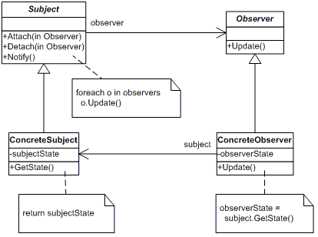
Observer

Slide 31
Applicability
Use the Observer pattern in any of the following situations:
When a change to one object requires changing others, and you don't know how many objects need to be changed.
When an object should be able to notify other objects without making assumptions about who these objects are. In other words, you don't want these objects tightly coupled.

Slide 32
Participants
Subject /Observable
knows its observers. Any number of Observer objects may observe a subject.
provides an interface for attaching and detaching Observer objects.
Observer
defines an updating interface for objects that should be notified of changes in a subject.
ConcreteSubject
stores state of interest to ConcreteObserver objects.
sends a notification to its observers when its state changes.
ConcreteObserver
maintains a reference to a ConcreteSubject object.
stores state that should stay consistent with the subject's.
implements the Observer updating interface to keep its state consistent with the subject's.

Slide 33
public class EquityShare extends Observable {
private double valuePerUnit;
public double getValuePerUnit() {return valuePerUnit;}
public void setValuePerUnit(double valuePerUnit) {
this.valuePerUnit = valuePerUnit;
setChanged();
notifyObservers();
}
}

Slide 34
public class EquitySubscriber implements Observer {
void update(Observable equityShare, Object arg) {
EquityShare share=(EquityShare) equityShare;
System.out.printLn("Share value changed to:" + equityShare.getValuePerUnit());
sendSms(equityShare.getValuePerUnit())
}
}

Slide 35
public class TestObseverPattern{
public static void main(String[] args){
EquityShare share = new EquityShare();
EquitySubscriber subscriber = new EquitySubscriber();
equityShare.addObserver(subscriber);
equityShare.setValuePerUnit(400.00);
}
}

Slide 36
Decorator
Attach additional responsibilities to an object dynamically
A Flexible alternative to subclassing for extending functionality.
It is also caller Wrapper design pattern
Use Decorator when the responsibilities are to be dynamically added (before or after current responsibilities). This is not possible with inheritance/subclassing.

Slide 37
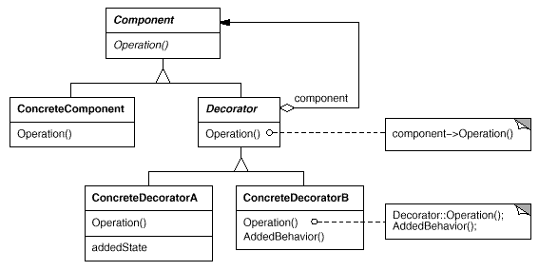
Decorator

Slide 38
Decorator - Problem Statement
Implement a fund transfer component which will take source account identifier, destination account identifier, amount to be transferred and carry out transfer of fund from source account to destination account.
Prior to actual transfer the transfer request details should be logged.
Prior to actual transfer the user requesting transfer operation must be authenticated to allow the transfer operation.
Prior to actual transfer the source account should be validated for adequate balance.
Since the three “pre” operations are independent of each other they should be carried out in any sequence.

Slide 39
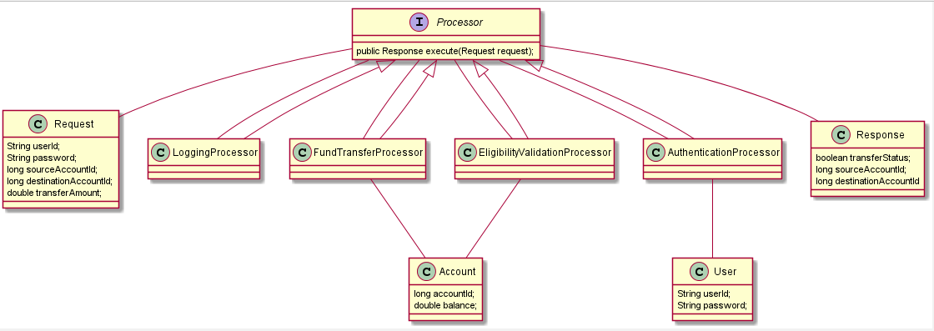
Decorator case study : Fund Transfer

Slide 40
Strategy
A Behavioral pattern used to define a family of algorithms, encapsulates each one, and make them interchangeable at runtime.
An alternative to avoid if-else type of logic separation into different behavior encapsulated strategy classes.
No impact of adding new behavior to the existing family of behaviors. Minimum impact if any of the existing behavior is modified.
Also known as Policy pattern

Slide 41
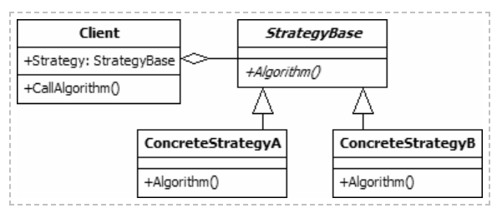
Strategy

Slide 42
Strategy – International Income Tax Calculator
Requirement is to implement an income tax calculator for different countries. The tax slabs are different; the exemptions (example: housing loan exemption) are also different.
Tax calculator should take Income and should be able to calculate applicable income tax for a specific country.
Income tax calculation is based on exemption rules (interest on fixed deposits, interest on other instrument, sale of property, sale of shares etc.) as well as slab rules. Exemptions are applied to total income thereby reducing the taxable amount. The slab rules then apply to the taxable amount and determine the percent of taxable amount that needs to be paid as income tax.
Each country may have their own policy of exemptions as well as tax slabs.

Slide 43
International Income Tax Calculator – typical implementation
Class ITCalculator {
public double calculateTax (Income, country){
if(country == “india”){
//determine exemptions to be applied
else if( country== “uk”){
//something else
}
……..
}
}

Slide 44
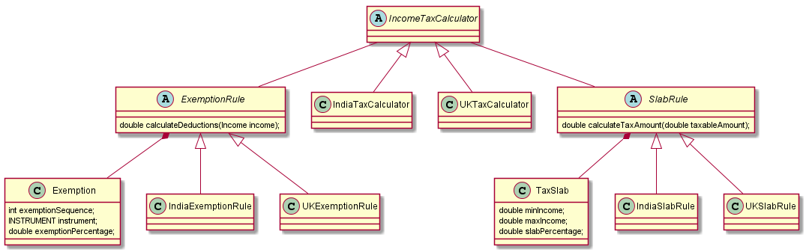
International Tax Calculator – A Better Approach

Slide 45
Proxy Pattern
Provide a “Placeholder” on an actual object of interest and control access to it.
Instead of obtaining reference of an actual object the client obtains reference of its “proxy”, without knowing that it is a proxy. Then it handles the proxy ,the same way it handles real subject. Since Proxy has the first chance to get executed, it can do things different than the actual subject such as verification of inputs, authentication, logging, invoking some pre-processing logic etc. Once this pre-processing is done then the actual subject is passed on the control for execution. In the same way the proxy can also do some post-processing(i.e. execution of logic AFTER the real subject has done with its processing logic)

Slide 46
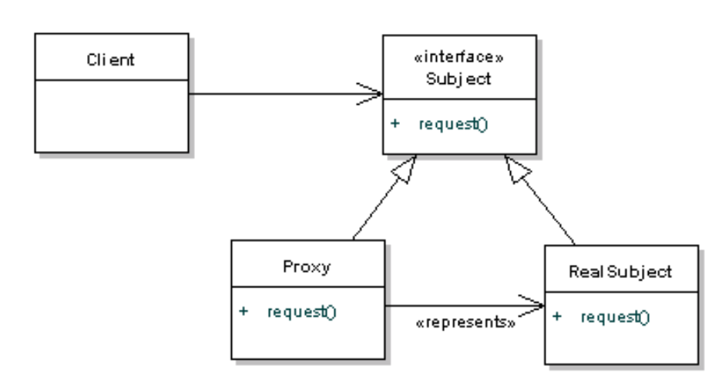
Proxy

Slide 47
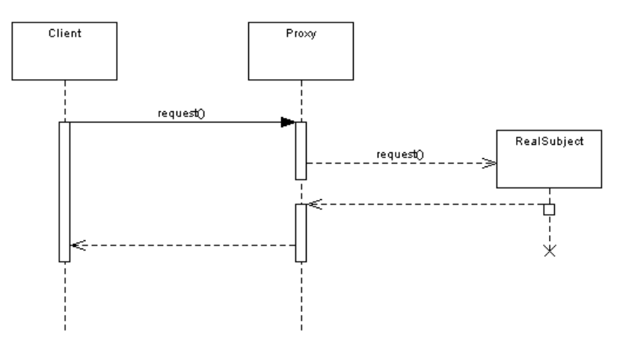
Proxy

Slide 48
Proxy - Problem Statement
We will use the same fund transfer logic as used for describing Decorator, but now will implement using proxy.
Implement a fund transfer component which will take source account identifier, destination account identifier, amount to be transferred and carry out transfer of fund from source account to destination account.
Prior to actual transfer the user requesting transfer operation must be authenticated to allow the transfer operation.
Once the authentication is successful then only the control is handed over to fund transfer processor for carrying out fund transfer.

Slide 49
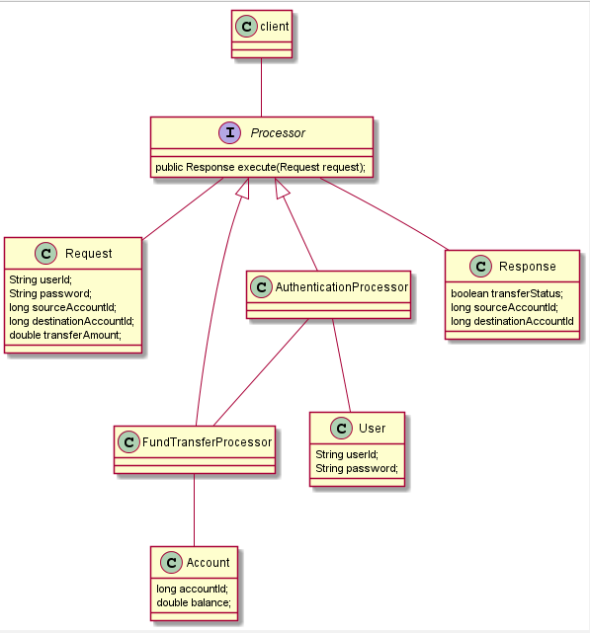
Proxy – Example Implementation

Slide 50
State Pattern
Behavioral Pattern
Allows object to alter its behavior when its internal state changes. The object will appear to change its class.

Slide 51
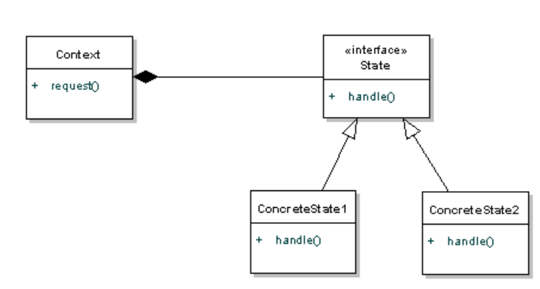
State

Slide 52
Facade
A facade is an object that provides a simplified interface to a larger body of code, such as a class library.
A facade can:
make a software library easier to use and understand, since the facade has convenient methods for common tasks;
make code that uses the library more readable, for the same reason;
reduce dependencies of outside code on the inner workings of a library, since most code uses the facade, thus allowing more flexibility in developing the system;
wrap a poorly designed collection of APIs with a single well-designed API (As per task needs).
It hides the complexities of the system and provides an interface to the client from where the client can access the system. In Java, the interface JDBC can be called a facade. We as users or clients create connection using the “java.sql.Connection” interface, the implementation of which we are not concerned about. The implementation is left to the vendor of driver.

Slide 53
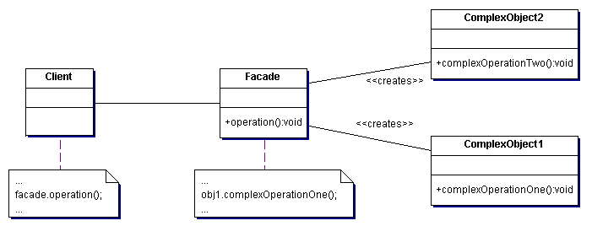
Facade

Slide 54
public interface Store{
public Goods getGoods();
}
public class FinishedGoodsStore implements Store
{ public Goods getGoods()
{ FinishedGoods finishedGoods = new FinishedGoods(); return finishedGoods; }
}// End of class

Slide 55
public class StoreKeeper
{
public Goods getGoods(String goodsType)
{
if (goodsType.equals("Packaging"))
{ PackingMaterialStore store = new PackingMaterialStore(); PackingMaterialGoods packingMaterialGoods = (PackingMaterialGoods)store.getGoods(); return packingMaterialGoods; } else if (goodsType.equals("Finished"))
{ FinishedGoodsStore store = new FinishedGoodsStore(); FinishedGoods finishedGoods = (FinishedGoods)store.getGoods(); return finishedGoods; } else
{ RawMaterialStore store = new RawMaterialStore(); RawMaterialGoods rawMaterialGoods = (RawMaterialGoods)store.getGoods(); return rawMaterialGoods; }
}// End of class

Slide 56
public class Client
{
/** * to get raw materials */ public static void main(String[] args)
{ StoreKeeper keeper = new StoreKeeper(); Goods rawMaterialGoods = keeper. getGoods ("Finished");
}
}// End of class

Slide 57
Quiz
Asian Paints offers wall decoration computerized sprayer unit, which paints a single wall with patterns of different colors. One or more color one time usable cylinders(each having compartments for paint and the thinner, and an internal mixer to mix paint and thinner) are connected to the sprayer unit. One has to configure number of colors to be used for painting a wall as color1,color2 and initiate the unit for painting. Accordingly each attached cylinder initiate mixing of paint and thinner so as to form a liquid form sprayable color. Which design pattern can be used to automate this process??
A business management system expect the merchant to set annual budget of the financial year for each expense header, as well as spends in that year. The budget(or spend against it) is not expected to be single value but should be comprised of monthly budget for each month. Merchant should be able to derive quarterly, half yearly or yearly budget and/or spend for that period. Which design pattern best suited for the same?

Slide 58
Quiz
An organization has hierarchy of employees working. Senior managers have managers reporting to them, managers have workers reporting to them and so on. Each employee role has some common set of attributes such as emp Id, designation, department, salary, joining date, reporting manager emp id etc. So far they were deprived of provident fund facility. But as per revised law they must get the PF facility where their contribution and employer contribution needs to be calculated by a computer program PFCalculator. The PF calculation is to be made retrospectively and hence based on their current salary and date of joining. Which all design patterns best suite this design?
PLC automation of a liquor plant is standardized in terms of process steps and the sequence in which liquor manufacturing process(addition of water and yeast, fermentation of barley, filtering etc). But according to the type of liquor ( blended whisky, single malt scotch) one or more process stemps need to be customized, but the overall workflow remains constant. Which design pattern is useful here?

Slide 59
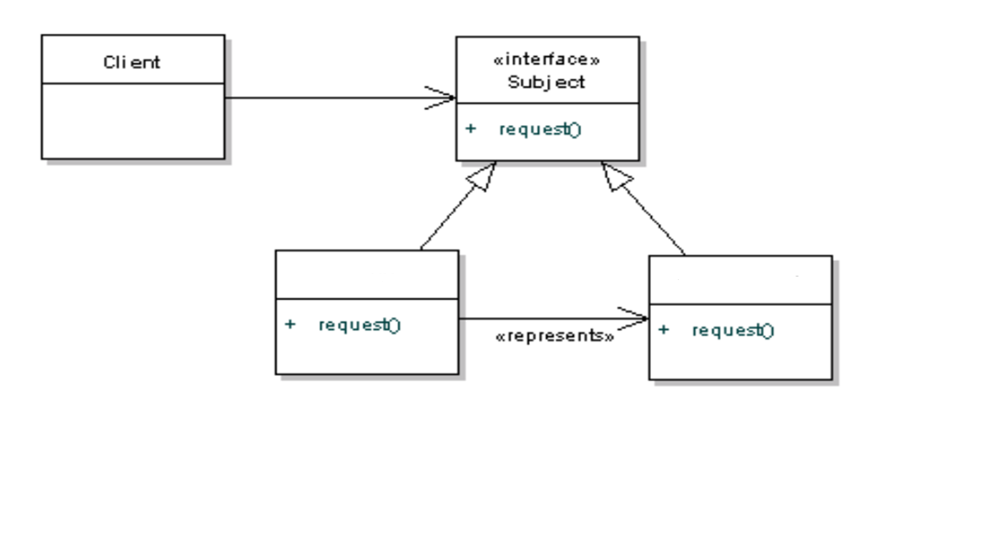
Quiz
Which is this pattern?

Slide 60
Quiz
When a heavy( large sized) image is to be loaded on the client’s browser, it takes long time to download due to its size and until it gets fully downloaded the user may get annoyed as nothing gets visible. IN order to engage the user, a low resolution, small sized counterpart/duplicate of the same actual image gets downloaded and displayed to the user. It creates an illusion of actual image in a process of getting downloaded. This is an example of which design pattern?
In a image analyzer a snapshot taken on camera goes through number of filters, some are reducing the hue/darkness element of the image whereas the other filter works on increasing the clarity of the image, third one validates a hidden signature in the image to validate its authenticity and then the image is fed to analyzer for image processing. These filters are independent of each other and need not follow any specific sequence of execution. Guess, which pattern?

Slide 61
Made to Order Laptop manufacturing- Problem Statement
Majority of the laptop buyers do not understand the intricacies of the technical specifications associated with various laptop models available in market, such as CPU models and cores, graphics cards of various resolutions and matching monitors, SDR vs DDR RAM, SSD vs HDD drives and so on.
Some high end models are fit for graphics designers or high end programmers, whereas moderate power models are fit for business purposes, low end models are useful for household purposes and so on. Obviously the models vary in their prices according to their tech. specifications.
Due to inability of the customer to choose laptop of exact required specification, they may not get value for money.
Customers may end up buying high end models which are not needed for their purpose. Alternatively they may choose one, which has lesser abilities than what they actually need for their purpose.
Another challenge is the ability to alter the specifications. The branded models come up with their predefined assembly of components, and if a customer wants an increased CPU power, enhanced graphics card or more RAM in a specific model, it is not supported out of the box, and doing so may invalidate its warranty clauses.

Slide 62
Case Study –Fit for purpose Laptop manufacturing
Infonix corporation has come up with an offering for its customers – Manufacturing of laptops as per the business case for which it is going to be used.
They have assembly lines which take up fed specifications, and assemble laptops.
Customer just needs to select the purpose and budget range. The system auto selects a suitable configuration and presents its technical specifications comprising of each compatible parts as well as price.
Upon customer approval the “compatible” parts suitable for selected purpose are fed to the assembly line in following sub assemblies
Motherboard assembly comprising of Motherboard, CPU and RAM
Power assembly comprising of Power adapter and Battery
Graphics assembly comprising of Graphics Card and a Monitor screen of compatible resolution
Storage assembly comprising of Storage drive( SSD or HDD).

Slide 63
Revision in specifications
Upon receiving the technical specifications and budget the customer may want to upgrade any of the components in the specifications.
In such case the definition of assembly is upgraded. The upgrade may not be straight forward, because the selected component upgrade may not be compatible with other components in the assembly specification. Hence they need to be changed/upgraded too.
So the assembly is redefined and revised specification as well as budget is sent to customer. Upon approval the same is assembled and tested in the factory/manufacturing unit.

Slide 64
Define assembly of laptop for chosen category
Case Study Part I

Slide 65
Decision 1 - Definition of Sub Assemblies
Problem Statement:
A laptop is not a collection of isolated,independent components, but it is an assembly of
sub-assmeblies where each sub-assembly has collection of related components.
Components in a sub-assembly are closely collaborating with each other, so as to deliver the function of that sub-assembly.

Slide 66
Definition of Sub Assemblies
Motherboard Assembly: A collaboration of following compatible components
CPU
RAM
Motherboard
Graphics Assmebly : A collaboration of following compatible components
Graphics Card
Screen(monitor) of appropriate resolution
Power Assembly: A collaboration of following compatible components
Power adapter
Battery
Storage Assmebly : Hard disc/SSD(Solid State Drive)

Slide 67
Decision 2- Laptop is a composition of components
Problem Statement: Define component structure for the following
Laptop is an assembly of multiple sub-assemblies such as motherboard assembly, power assembly, display assembly
Each sub-assembly can be termed as a component of laptop assembly, capable of handling one aspect of laptop functioning and each should further contain a list of related child assemblies/components and so on.
The leaf of each sub/child assembly is a component such as CPU, motherboard, RAM etc.

Slide 68
AssemblyComponent
addToAssmebly()
removeFromAssembly()
assemble()
CompositeComponent
LeafComponent
AbstractCPU
AbstractMBoard
AbstractGraphicsCard
AbstractRAM
AbstractScreen
AbstractAdapter
AbstractHDD
AbstractBattery
Composite

Slide 69
Decision 3 - Selection of appropriate assembly selectors
Problem Statement:
Choose appropriate assembly selectors for the given budget category.

Slide 70
Design- Budget based selection of assemblies
AssemblyComponentFamilySelector
ComponentsSelectionFactory
Selector create(BUDGET)
getMotherboardFamilySelector()
getGraphicsFamilySelector()
getPowerFamilySelector ()
getStorageFamilySelector()
PowerFamilySelector
MBoardFamilySelector
GraphicsFamilySelector
StorageFamilySelector
BusinessPurposeCompsSelectionFactory
HigherEndPurposeCompsSelectionFactory
create(BUDGET)
create(BUDGET)
GraphicsPurposeCompsSelectionFactory
create(BUDGET)
Factory Method

Slide 71
Decision 4- Selection of family of compatible components
Problem Statement:
Each Selector should be capable for providing list of associated components in respective sub assembly,which are compatible to each other as well as fiting in the business requirements and budget.

Slide 72
Design – Selection of family of compatible components
Ass.Component
ComponentsFamilySelector
Ass.Component selectCompatibleAssemblyComponents
(ComponentType)
StorageFamily
MotherboardFamily
PowerFamily
GraphicsFamily
LowProcessingMotherboardFamilySeletor
MediumProcessingMotherboardFamilySelector
HIghProcessingMotherboardFamilySelector
Abstract Factory

Slide 73
Print Specifications
Case Study Part II

Slide 74
Decision 5- Print component-wise specification
Problem Statement:
Each component definition maintains its own specifications.
Specification of entire laptop assembly is nothing but aggregation of specifications of each of its components
Component itself is not responsible for printing the specification of its own, but we should be able to dynamically add a behavior to print specification of the laptop assembly.

Slide 75
IVisitable
IVisitor
accept(Ivisitor)
visit(Ivisitable)
Client
AssemblyComponent
SpecificationPrinter
visit(Ivisitable)
{
Print specs of each component visited.
}
LeafComponent
CompositeComponent
Visitor

Slide 76
Upgrade Assembly configuration
Case Study Part III

Slide 77
Decision 6- Change of selection of a component
Problem Statement:
When a recommended configuration according to purpose and budget is derived, printed and shown to the customer, he/she may wants to alter one or more parts in it; ex: Selection of I5 processor instead of AMD Ryzen5
Components have to be compatible with each other; Thus if one component changes system should
Validate if other components in current assembly are compatible to the changed component.
Change all those components which are not compatible, by the compatible ones fitting purpose and budget.

Slide 78
UpgraderRequest
AssemblyUpgrader
Client
UpgraderChain
AssemblyComponent upgrade (Request, Assmebly)
AssemblyComponent upgrade(Request, Assmebly)
setNext(AssemblyUpgrader)
AssemblyComponent
CPUUpgrader
BoardUpgrader
RAMUpgrader
GraphicsUpgrader
BatteryUpgrader
StorageUpgrader
AdapterUpgrader
Chain Of Responsibility – Change Component ( and associated non-compatible components)

Slide 79
Pre Assembly Testing - Test selected assembly components
Case Study Part IV

Slide 80
Decision 7- Test each selected component of prior to assembling
Problem Statement:
Once customer finalize the laptop configuration, its compatible assembly components are procured and each one needs to be tested in isolation before it is to be used for assembly.
Since each component if of different type, it may have different mechanism to do its quality check.
System should have ability to select appropriate verifier as per the component under test and carry out QC.
If any of the QC for a components fails, then system should raise error and stop further verification.

Slide 81
CPUPreTestVerifier
MotherboardPreTestVerifier
AssemblyComponentVerifier
boolean qualityCheck (AssemblyComponent)
BatteryPreTestVerifier
RAMPreTestVerifier
VerifierStaticFactory
AssemblyComponentVerifier createVerifier
(AssemblyComponent)
AdapterPreTestVerifier
GraphicsCardPreTestVerifier
HDDPreTestVerifier
Static Factory

Slide 82
IVisitable
IVisitor
accept(Ivisitor)
visit(Ivisitable)
Client
AssemblyComponent
PreTestDecorator
visit(Ivisitable)
{
Obtain appropriate verifier and verify component
}
LeafComponent
CompositeComponent
Visitor

Slide 83
Post Assembly Testing - Test Entire assembled laptop
Case Study Part V

Slide 84
Decision 8- Test assembled laptop for its entire functionality
Problem Statement:
Once laptop is assembled using selected components, it needs to be tested for proper functioning
There is a minimum mandatory tests applicable for all laptop types, regardless of ingredient components.
Some tests are applicable only if few specific components are added to the assembly; ex: Gaming Graphics Card.
Appropriate tests should be dynamically added when required.

Slide 85
IVisitable
accept(Ivisitor)
AssemblyComponent
assemble()
LeafComponent
CompositeComponent
AssemblyComponentBaseDecorator
AssemblyComponentVerifier
PostTestDecorator
assemble()
LaptopAssemblyPostTestVerifier
Decorator

